Slide 1
Introduction to SQL

Slide 2
Outline
Domain Types in SQL
Basic Schema Definition
Create table, Insert, Update, Delete, Drop, Alter
Basic Structure of SQL Queries
Queries on a Single Relation
Queries on Multiple Relations
The select Clause
The where Clause
The from Clause
String Operations
Set Operations
Null Values
Aggregate Functions
Nested Subqueries

Slide 3
Basic Domain Types in SQL
char(n)
A FIXED length string. The size parameter specifies the column length in characters - can be from 0 to 255. Default is 1
varchar(n)
A VARIABLE length string (can contain letters, numbers, and special characters). The size parameter specifies the maximum column length in characters - can be from 0 to 65535
int
A medium integer. Signed range is from -2147483648 to 2147483647. Unsigned range is from 0 to 4294967295.
Smallint
A small integer. Signed range is from -32768 to 32767. Unsigned range is from 0 to 65535.

Slide 4
Basic Domain Types in SQL
numeric(p,d)
Fixed point number, with user-specified precision of p digits, with d digits to the right of decimal point.
ex., numeric(3,1), allows 44.5 to be stores exactly, but not 444.5 or 0.32
real, double precision
Floating point and double-precision floating point numbers
float(n)
Floating point number. You can use n to specify the precision of a FLOAT data type. The value n must be a whole number between 1 and 14.

Slide 5
Create Table Construct
An SQL relation is defined using the create table command:
create table r (A₁ D₁, A₂ D₂, ..., A_{n} D_{n}, (integrity-constraint₁), ..., (integrity-constraint_{k}))
r is the name of the relation
each A_{i} is an attribute name in the schema of relation r
D_{i} is the data type of values in the domain of attribute A_{i}
Example:
create table instructor ( ID char(5), name varchar(20), dept_name varchar(20), salary numeric(8,2))

Slide 6
Integrity Constraints in Create Table
not null
primary key (A₁, ..., A_{n} )
foreign key (A_{m}, ..., A_{n} ) references r
Example:
create table instructor ( ID char(5), name varchar(20) not null, dept_name varchar(20), salary numeric(8,2), primary key (ID), foreign key (dept_name) references department(dept_name));
primary key declaration on an attribute automatically ensures not null

Slide 7
Integrity Constraints in Create Table
create table student ( ID varchar(5), name varchar(20) not null, dept_name varchar(20), tot_cred numeric(3,0), primary key (ID),
foreign key (dept_name) references department);
create table takes ( ID varchar(5), course_id varchar(8), sec_id varchar(8), semester varchar(6), year numeric(4,0), grade varchar(2),
primary key (ID, course_id, sec_id, semester, year) ,
foreign key (ID) references student, foreign key (course_id, sec_id, semester, year) references section);

Slide 8
Integrity Constraints in Create Table
create table course ( course_id varchar(8), title varchar(50), dept_name varchar(20), credits numeric(2,0),
primary key (course_id),
foreign key (dept_name) references department);

Slide 9
Integrity Constraints in Create Table
Instructor
student
ID
name dept_name
salary
ID
name dept_name
Total_cred
takes
department
ID course_id sec_id semester year grade
dept name
building budget
section
teaches
course
course id
sec id semester
year
building room_number,
Time_slot_id
ID course_id sec_id semester year
course_id title dept_name credits

Slide 10
Updates to tables
Insert
insert into instructor values (‘10211’, ’Smith’, ’Biology’, 66000);
Delete
Remove all tuples from the student relation
delete from student
Drop Table
drop table r
Alter
alter table r add A D
where A is the name of the attribute to be added to relation r and D is the domain of A.
All exiting tuples in the relation are assigned null as the value for the new attribute.
alter table r drop A
where A is the name of an attribute of relation r
Dropping of attributes not supported by many databases

Slide 11
Basic Query Structure
A typical SQL query has the form: select A₁, A₂, ..., A_{n} from r₁, r₂, ..., r_{m} where P
A_{i} represents an attribute
R_{i} represents a relation
P is a predicate.
The result of an SQL query is a relation.

Slide 12
The select Clause
The select clause lists the attributes desired in the result of a query
corresponds to the projection operation of the relational algebra
Example: find the names of all instructors: select name from instructor
NOTE: SQL names are case insensitive (i.e., you may use upper- or lower-case letters.)
E.g., Name ≡ NAME ≡ name

Slide 13
The select Clause
SQL allows duplicates in relations as well as in query results.
To force the elimination of duplicates, insert the keyword distinct after select.
Find the department names of all instructors, and remove duplicates
select distinct dept_name from instructor
The keyword all specifies that duplicates should not be removed.
select all dept_name from instructor

Slide 14
The select Clause
An asterisk in the select clause denotes “all attributes”
select * from instructor
An attribute can be a literal with no from clause
select ‘437’
Results is a table with one column and a single row with value “437”
Can give the column a name using:
select ‘437’ as FOO
An attribute can be a literal with from clause
select ‘A’ from instructor
Result is a table with one column and N rows (number of tuples in the instructors table), each row with value “A”

Slide 15
The select Clause
The select clause can contain arithmetic expressions involving the operation, +, –, ∗, and /, and operating on constants or attributes of tuples.
The query:
select ID, name, salary/12 from instructor
would return a relation that is the same as the instructor relation, except that the value of the attribute salary is divided by 12.
Can rename “salary/12” using the as clause:
select ID, name, salary/12 as monthly_salary

Slide 16
The where Clause
The where clause specifies conditions that the result must satisfy
To find all instructors in Comp. Sci. dept
select name from instructor where dept_name = ‘Comp. Sci.'
Comparison results can be combined using the logical connectives and, or, and not
To find all instructors in Comp. Sci. dept with salary > 80000
select name from instructor where dept_name = ‘Comp. Sci.' and salary > 80000
Comparisons can be applied to results of arithmetic expressions.

Slide 17
The from Clause
The from clause lists the relations involved in the query
Find the Cartesian product instructor X teaches
select ∗ from instructor, teaches
generates every possible instructor – teaches pair, with all attributes from both relations.
Cartesian product not very useful directly, but useful when combined with where-clause condition

Slide 18
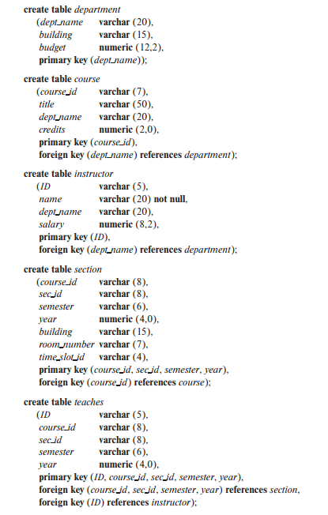
The from Clause
Find the names of all instructors who have taught some course and the course_id
select name, course_id from instructor , teaches where instructor.ID = teaches.ID
Find the names of all instructors in the Comp. Sci. department who have taught some course and the course_id
select name, course_id from instructor , teaches where instructor.ID = teaches.ID and instructor. dept_name = ‘Comp. Sci.’

Slide 19
The Rename Operation
The SQL allows renaming relations and attributes using the as clause:
old-name as new-name
Find the names of all instructors who have a higher salary than some instructor in ‘Comp. Sci’.
select distinct T.name from instructor as T, instructor as S where T.salary > S.salary and S.dept_name = ‘Comp. Sci.’
Keyword as is optional and may be omitted instructor as T ≡ instructor T

Slide 20
String Operations
SQL includes a string-matching operator for comparisons on character strings. The operator like uses patterns that are described using two special characters:
percent ( % ). The % character matches any substring.
underscore ( _ ). The _ character matches any character.
Find the names of all instructors whose name includes the substring “dar”.
select name from instructor where name like '%dar%'

Slide 21
String Operations
Patterns are case sensitive.
Pattern matching examples:
‘Intro%’ matches
any string beginning with “Intro”.
‘%Comp%’ matches any string
containing “Comp” as a substring.
‘_ _ _’ matches any string of
exactly three characters.
‘_ _ _ %’ matches any string of
at least three characters.
SQL supports a variety of string operations such as
concatenation
converting from upper to lower case (and vice versa)
finding string length, extracting substrings, etc.

Slide 22
Ordering the Display of Tuples
List in alphabetic order the names of all instructors
select distinct name from instructor order by name
We may specify desc for descending order or asc for ascending order, for each attribute; ascending order is the default.
Example: order by name desc
Can sort on multiple attributes
Example: order by dept_name, name

Slide 23
Where Clause Predicates
SQL includes a between comparison operator
Example: Find the names of all instructors with salary between $90,000 and $100,000 (that is, ≥ $90,000 and ≤ $100,000)
select name from instructor where salary between 90000 and 100000
Tuple comparison
select name, course_id from instructor, teaches where (instructor.ID, dept_name) = (teaches.ID, ’Biology’);

Slide 24
Set Operations
Find courses that ran in Fall 2019 or in Spring 2020 for section 1
(select course_id from section where semester = "Fall" and year = 2019 and sec_id=1)
Union
(select course_id from section where semester = "Spring" and year = 2020 and sec_id=1)
Find courses that ran in Fall 2019 and in Spring 2020 for section 1
(select course_id from section where semester = ‘Fall’ and year = 2019) intersect (select course_id from section where sem = ‘Spring’ and year = 2020)
Not supported by all the version of mysql
SELECT DISTINCT course_id FROM section WHERE semester="FALL" and year = 2019 and sec_id=1 and course_id IN (SELECT course_id FROM section where semester="Spring" and year = 2020 and sec_id=1);

Slide 25
Set Operations
Find courses that ran in Fall 2019 but not in Spring 2020
(select course_id from section where semester = "Fall" and year = 2019)
except
(select course_id from section where semester = "Spring" and year = 2020)
Not supported by all the version of mysql
Find the salaries of all instructors that are less than the largest salary.
Select distinct T.salary from instructor as T, instructor as S
where T.salary < S.salary

Slide 26
Set Operations
Set operations union, intersect, and except
Each of the above operations automatically eliminates duplicates
To retain all duplicates use the corresponding multiset versions union all, intersect all and except all.
suppose a tuple occurs m times in r and n times in s, then, it occurs:
m + n times in r union all s
min(m,n) times in r intersect all s
max(0, m – n) times in r except all s
Duplicate instances are supported in some relational database

Slide 27
Null Values
It is possible for tuples to have a null value, denoted by null, for some of their attributes
null signifies an unknown value or that a value does not exist.
The result of any arithmetic expression involving null is null
Example: 5 + null returns null
The predicate is null can be used to check for null values.
Example: Find all instructors whose salary is null.
select name from instructor where salary is null

Slide 28
Null Values and Three Valued Logic
Three values – true, false, unknown
Any comparison with null returns unknown
Example: 5 < null or null <> null or null = null
Three-valued logic using the value unknown:
OR: (unknown or true) = true, (unknown or false) = unknown (unknown or unknown) = unknown
AND: (true and unknown) = unknown, (false and unknown) = false, (unknown and unknown) = unknown
NOT: (not unknown) = unknown
Result of where clause predicate is treated as false if it evaluates to unknown

Slide 29
Aggregate Functions
These functions operate on the multiset of values of a column of a relation, and return a value
avg: average value min: minimum value max: maximum value sum: sum of values count: number of values

Slide 30
Aggregate Functions
Find the total number of instructors who teach a course in the Fall 2019 semester
select count(distinct ID) from teaches
where semester = "Fall" and year = 2019;

Slide 31
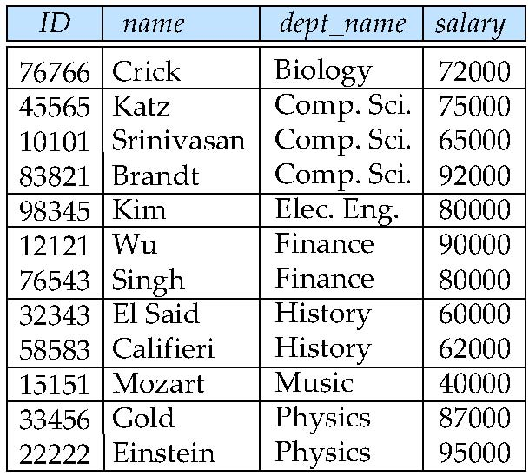
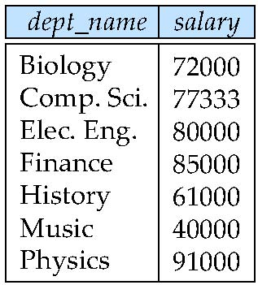
Aggregate Functions – Group By
Find the average salary of instructors in each department
select dept_name, avg (salary) as avg_salary from instructor group by dept_name;

Slide 32
Aggregation
Attributes in select clause outside of aggregate functions must appear in group by list
/* erroneous query */ select dept_name, ID, avg (salary) from instructor group by dept_name;

Slide 33
Aggregate Functions – Having Clause
Find the names and average salaries of all departments whose average salary is greater than 42000
select dept_name, avg (salary)
from instructor
group by dept_name
having avg(salary) > 42000;
Note: predicates in the having clause are applied after the formation of groups whereas predicates in the where clause are applied before forming groups

Slide 34
Nested Subqueries
SQL provides a mechanism for the nesting of subqueries. A subquery is a select-from-where expression that is nested within another query.
The nesting can be done in the following SQL query select A₁, A₂, ..., A_{n} from r₁, r₂, ..., r_{m} where P
as follows:
A_{i} can be replaced by a subquery that generates a single value.
r_{i} can be replaced by any valid subquery
P can be replaced with an expression of the form:
B <operation> (subquery)
Where B is an attribute and <operation> to be defined later.

Slide 35
Subqueries in the Where Clause
A common use of subqueries is to perform tests:
For set membership
For set comparisons
For set cardinality.

Slide 36
Subqueries in the Where Clause
Find courses that ran in Fall 2019 and in Spring 2020
select distinct course_id
from section
where semester = ’Fall’ and year= 2019 and course_id in (select course_id
from section
where semester = ’Spring’ and year= 2020);

Slide 37
Subqueries in the Where Clause
Find courses that ran in Fall 2019 but not in Spring 2020
select distinct course_id
from section
where semester = ’Fall’ and year= 2019 and course_id not in (select course_id
from section
where semester = ’Spring’ and year= 2020);

Slide 38
Set Membership
Find the total number of (distinct) students who have taken course sections taught by the instructor with ID 10101
select count (distinct ID)
from takes
where (course_id, sec_id, semester, year) in (select course_id, sec_id, semester, year
from teaches
where teaches.ID= 10101);

Slide 39
Set Comparison – “some” Clause
Find names of instructors with salary greater than that of some (at least one) instructor in the Biology department.
select distinct T.name
from instructor as T, instructor as S
where T.salary > S.salary and S.dept_name = ’Biology’;
Same query using > some clause
select name
from instructor
where salary > some (select salary
from instructor
where dept_name = ’Biology’);

Slide 40
Definition of “some” Clause
F <comp> some r ⇔ ∃ t ∈ r such that (F <comp> t ) Where <comp> can be: <, ≤, >, =, ≠
0
(5 < some
5
) = true
(read: 5 < some tuple in the relation)
6
0
(5 < some
5
) = false
0
(5 = some
) = true
5
0
(5 ≠ some
5
) = true (since 0 ≠ 5)

Slide 41
Set Comparison – “all” Clause
Find the names of all instructors whose salary is greater than the salary of all instructors in the Biology department.
select name
from instructor
where salary > all (select salary
from instructor
where dept_name = ’Biology’);

Slide 42
Definition of “all” Clause
F <comp> all r ⇔ ∀ t ∈ r (F <comp> t)
0
(5 < all
5
) = false
6
6
(5 < all
) = true
10
4
(5 = all
) = false
5
4
(5 ≠ all
) = true (since 5 ≠ 4 and 5 ≠ 6)
6

Slide 43
Test for Empty Relations
The exists construct returns the value true if the argument subquery is nonempty.
exists r ⇔ r ≠ Ø
not exists r ⇔ r = Ø
Find courses that ran in Fall 2019 and in Spring 2020
select course_id from section as S where semester = ’Fall’ and year = 2019 and exists (select * from section as T where semester = ’Spring’ and year= 2020 and S.course_id = T.course_id);

Slide 44
Subqueries in the Form Clause
Find the average instructors’ salaries of those departments where the average salary is greater than $42,000.”
select dept_name, avg (salary)
from instructor
group by dept_name
having avg(salary) > 42000;
select dept_name, avg_salary from (select dept_name, avg (salary) as avg_salary from instructor group by dept_name) where avg_salary > 42000;

Slide 45
With Clause
The with clause provides a way of defining a temporary relation whose definition is available only to the query in which the with clause occurs.
Find all departments with the maximum budget
with max_budget(value) as
(select max(budget) from department)
select department.dept_name
from department, max_budget
where department.budget = max_budget.value;

Slide 46
Subqueries in the Select Clause
Scalar Subquery
Scalar subquery is one which is used where a single value is expected
List all departments along with the number of instructors in each department
select dept_name, (select count(*) from instructor where department.dept_name = instructor.dept_name) as num_instructors from department;
Runtime error if subquery returns more than one result tuple

Slide 47
Exercise
Find all departments where the total salary is greater than the average of the total salary at all departments
Increase salaries of instructors whose salary is over $100,000 by 3%, and all others by a 5%

Slide 48
Case Statement for Conditional Updates
Increase salaries of instructors whose salary is over $100,000 by 3%, and all others by a 5%
update instructor set salary = case when salary <= 100000 then salary * 1.05 else salary * 1.03 end

Slide 49
References
Abraham Silberschatz, Henry F. Korth, and S. Sudarshan, Database System Concepts, 7/e
Adhsakkdi Y, Raghuram Krishnan and Johannes Gehrke, Database Management Systems, 3/e, TMH, 2007.
Some of the figures and Examples are taken from various online sources.

